Slide 1


TDD for the newb Who Wants to Become an Apprentice
Howard Deiner
Agile Technical Practices and Process Coach
SolutionsIQ, Redmond WA, USA
Join the conversation on Twitter: @DevWeek // #DW2016 // #DevWeek

Slide 2

Agenda
Join the conversation on Twitter: @DevWeek // #DW2016 // #DevWeek

Slide 3
Get organized for the day
Validate IDE configurations with a TDD for “Hello World”.
Description of the day’s project
A CreditCard class (credit card number validation)
A Merchant class (UK postal code, UK phone, and email validation)
What in the world are test doubles?
A Merchant wants to go postal (test double via fake)
A Merchant actually goes postal (REST WS called)
A Customer class (refactor to reuse)
An Order class (distance computation)
Let’s talk about code coverage
Questions, Answers, Debate, Depart
Join the conversation on Twitter: @DevWeek // #DW2016 // #DevWeek

Slide 4

Getting
Organized
Join the conversation on Twitter: @DevWeek // #DW2016 // #DevWeek

Slide 5
A few ground rules:
Be considerate of others.
Don’t be afraid to say, “I don’t understand.” No one is expected to understand this material yet.
If you don’t try, you won’t learn. I can give you my implementations for code if we need to move on, but the effort you put in is proportional to the benefit you will receive.
This workshop will presume basic Java knowledge and use the basic Eclipse for Java Developers IDE. If you wish to use another IDE, that’s fine.
And now, I’d like everyone to find a partner. Pairing works really well in this environment. Try it. You’ll like it!
You will find this deck, as well as worked out code samples (but don’t cheat during the workshop!) at
https://github.com/hdeiner/DevWeek2016-TDD-for-the-Newb-Who-Wants-to-Become-an-Apprentice.git
Join the conversation on Twitter: @DevWeek // #DW2016 // #DevWeek

Slide 6

JUnit
“Hello World”
Join the conversation on Twitter: @DevWeek // #DW2016 // #DevWeek

Slide 7
Write a class called “HelloWorld”.
This class will have a String method called “respondTo”, whichs takes one String parameter.
We want to have an object of the HelloWorld class respondTo “hello” with “world”.
And we want an object of the HelloWorld class respondTo “Bernie” with “Sanders”.
Let’s do this together, writing the code using the TDD 5 Step Cycle:
Write a test
Make sure the test fails for the right reason
Write just enough code to make the test pass
Make sure that all the tests still pass
Refactor
Join the conversation on Twitter: @DevWeek // #DW2016 // #DevWeek

Slide 8

What’s in store for the rest of the day?
Join the conversation on Twitter: @DevWeek // #DW2016 // #DevWeek

Slide 9
The theme for the day’s work revolves around a website that we intend to build.
Said website will allow a Customer to use one of their CreditCards to buy from a Merchant. (I know. A totally unique idea).
We will be constructing the three classes from above.
We will be doing a lot of field validation,and testing that the validations repond properly.
Later in the day, we will be doing some validation on UK postal codes using Web Service APIs provided by https://postcodes.io. We will also be collecting geolocation data.
And finally, our project will calculate distance between Customer and Merchant addresses. Mostly, so we have some more code to develop using TDD.
Join the conversation on Twitter: @DevWeek // #DW2016 // #DevWeek

Slide 10

The CreditCard Class
Join the conversation on Twitter: @DevWeek // #DW2016 // #DevWeek

Slide 11
We’ve all used credit cards for online purchases, right?
You tell the system your numbers, your expiration date, your CVV (card verification value), and off you go!
We’re not going to actually be submitting any credit charges today, so we’re not going to worry about the expiration date and CVV. But we will be going deeply into validating the credit card’s numbers. They can tell us a real story, and we can actually make sure that the numbers given make sense before we ever try to use them!
For example, did you know that all credit card numbers actually have a checksum built into them? It’s true! In fact, IBM scientist Hans Peter Luhn was granted a US Patent on his “Luhn Algorithm” back in 1960.
Join the conversation on Twitter: @DevWeek // #DW2016 // #DevWeek

Slide 12
The Luhn Algorithm
Drop the last digit from the number. The last digit is what we want to check against
Reverse the numbers
Multiply the digits in odd positions (1, 3, 5, etc.) by 2 and subtract 9 to all any result higher than 9
Add all the numbers together
The check digit (the last number of the card) is the amount that you would need to add to get a multiple of 10 (modulo 10).
Modulo 10 of the sum of all the numbers plus the checkDigit should equal zero.
Join the conversation on Twitter: @DevWeek // #DW2016 // #DevWeek

Slide 13
Example of Working the Luhn Algorithm
Step Total
Original Number: 4 5 5 6 7 3 7 5 8 6 8 9 9 8 5 5
Drop the last digit: 4 5 5 6 7 3 7 5 8 6 8 9 9 8 5
Reverse the digits: 5 8 9 9 8 6 8 5 7 3 7 6 5 5 4
Multiple odd digits by 2: 10 8 18 9 16 6 16 5 14 3 14 6 10 5 8
Subtract 9 to numbers over 9: 1 8 9 9 7 6 7 5 5 3 5 6 1 5 8
Add all numbers: 1 8 9 9 7 6 7 5 5 3 5 6 1 5 8 85
Mod 10: (85+5) modulo 10 = 0 (5 was the last digit of card)
Whatever else happens today, you’ve at least found a way to check for transcription errors when entering credit card numbers.
But wait, there’s more to know about credit card numbers!
Join the conversation on Twitter: @DevWeek // #DW2016 // #DevWeek

Slide 14
Various Credit Card Issuers Have Different Formats
Credit Card Issuer Starts With Length
American Express 34, 37 15
Diners Club - Carte Blanche 300, 301, 302, 303, 304, 305 14
Diners Club - International 36 14
Diners Club - USA & Canada 54 16
Discover 6011, 622126 to 622925, 644, 645, 646, 647, 648, 649, 65 16
InstaPayment 637, 638, 639 16
JCB 3528 to 3589 16
Laser 6304, 6706, 6771, 6709 16-19
Maestro 5018, 5020, 5038, 5893, 6304, 6759, 6761, 6762, 6763 16-19
MasterCard 51, 52, 53, 54, 55 16-19
Visa 4 13-16
Visa Electron 4026, 417500, 4508, 4844, 4913, 4917 16
Join the conversation on Twitter: @DevWeek // #DW2016 // #DevWeek

Slide 15
For final testing, here are valid card numbers. You can make up your own bad numbers.
VISA 4485999990287897 4916526029752812 4539696491343569 | MasterCard 5315571812010758 5148442462496387 5590456078838330 | American Express 372354590612298 379786717424615 344545022650393
Discover 6011571608164376 6011451808735426 6011686546895236 | JCB 3158304464572924 3112184521307356 3158938116950200 | Diners Club - North America 5510050509751175 5557142064959709 5405084407199367
Diners Club - Carte Blanche 30344023257021 30091117396997 30478764169001 | Diners Club – International 36193482992253 36314264739742 36104261563793 | Maestro 6763709843268368 6759233278986184 6304537298512113
LASER 6771485405590909 6706323137698726 6304542517832193 | Visa Electron 4508823435239888 4175008932920428 4917994137916076 | InstaPayment 6395821636176587 6378944580148062 6376872922774166
Join the conversation on Twitter: @DevWeek // #DW2016 // #DevWeek

Slide 16
Rules for CreditClass
The constructor takes in one String argument – the card number
An Exception must be thrown if the Luhn Algorithm shows a bad card number
An Exception must be thrown if none of the starts with and length rules match
Have the constructor figure out the card issuer as well and keep it as a private attribute.
Create a public String method called getCardIssuer, and have it return the card issurer.
Join the conversation on Twitter: @DevWeek // #DW2016 // #DevWeek

Slide 17
Time to get to work!
I’ll be roming around answering
questions and helping those who need it.
Don’t be afraid to ask for help.
Don’t allow yourself to get stuck!
Join the conversation on Twitter: @DevWeek // #DW2016 // #DevWeek

Slide 18

The Merchant
Class
Join the conversation on Twitter: @DevWeek // #DW2016 // #DevWeek

Slide 19
Now it’s time to consider the Merchant class. How hard could that posibly be?
Well, if you’re as devious as I am, there could be plenty to do. Remember, our goal for these classes is to make the data that they collect as pure as we can make them by rigoursly keeping the data clean and free from entry flaws.
Merchants have:
A name
An address
A postalcode
A phone number
An eMail address
And yes, there will be rules.
Join the conversation on Twitter: @DevWeek // #DW2016 // #DevWeek

Slide 20
Write the Merchant class and specify all of the attributes in the constructor.
For now, any names that come in should be scrubbed to eliminate leading and trailing blanks. No errors, just trimming. And there must be a some name.
Likewise for addresses. We should silently trim away leading and trailing spaces. But so long as there is an address, we’re fine. For now.
The other fields are a different story…
Join the conversation on Twitter: @DevWeek // #DW2016 // #DevWeek

Slide 21
Postal Code Validation
According to wikipedia, at https://en.wikipedia.org/wiki/Postcodes_in_the_United_Kingdom, there is a definate format to a UK postalcode.
Format (A=letter,N=digit, mind the space) | Coverage | Example
AA9A 9AA | WC postcode area; EC1–EC4, NW1W, SE1P, SW1 | EC1A 1BB
A9A 9AA | E1W, N1C, N1P | W1A 0AX
A9 9AA | B, E, G, L, M, N, S, W | M1 1AE
A99 9AA |  | B33 8TH
AA9 9AA | All other postcodes | CR2 6XH
AA99 9AA |  | DN55 1PT
Join the conversation on Twitter: @DevWeek // #DW2016 // #DevWeek

Slide 22
UK Phone Number Validation
UK phone numbers can be either 10 or 11 digits long (with the exception of some special numbers, but we’re not going to worry about them).
They consist of an area code followed by a local number.
The area code varies in length between three and five digits, and the local portion of the number takes up the remaining length of the 10 or 11 digits.
For all practical purposes, no-one ever quotes just the local portion of their number, so you can ignore the distinction now, except for how it affects formatting.
They start with zero. Possibly with the country cod of +44 in front of it.
The second digit can be anything. Currently no valid numbers start with 04 or 06, but there's nothing stopping these ranges coming into use in the future. (03 has recently been brought into use).
They can be formatted with a set of brackets for the area code and with spaces (one or more, in varying positions), but those are all entirely optional.
Join the conversation on Twitter: @DevWeek // #DW2016 // #DevWeek

Slide 23
eMail Validation
The format of email addresses is local-part@domain where the local-part may be up to 64 characters long and the domain name may have a maximum of 255 characters. See https://en.wikipedia.org/wiki/Email_address
Local part
The local-part of the email address may use any of these ASCII characters:
Uppercase and lowercase Latin letters (A–Z, a–z) and digits 0 to 9
Specified special characters: !#$%&'*+-/=?^_`{|}~
Character . (dot, period, full stop), provided that it is not the first or last character, and provided also that it does not appear consecutively (e.g. John..Doe@example.com is not allowed).
Space and "(),:;<>@[\] characters are allowed with restrictions (they are only allowed inside a quoted string, as described in the paragraph below, and in addition, a backslash or double-quote must be preceded by a backslash).
Comments are allowed with parentheses at either end of the local part; e.g. john.smith(comment)@example.com and (comment)john.smith@example.com are both equivalent to john.smith@example.com.
Join the conversation on Twitter: @DevWeek // #DW2016 // #DevWeek

Slide 24
eMail Validation - continued
Local part – continued
A quoted string may exist as a dot separated entity within the local-part, or it may exist when the outermost quotes are the outermost characters of the local-part (e.g., abc."defghi".xyz@example.com or "abcdefghixyz"@example.com are allowed.
Conversely, abc"defghi"xyz@example.com is not; neither is abc\"def\"ghi@example.com).
Quoted strings and characters however, are not commonly used.
RFC 5321 also warns that "a host that expects to receive mail SHOULD avoid defining mailboxes where the Local-part requires (or uses) the Quoted-string form".
The local-part postmaster is treated specially–it is case-insensitive, and should be forwarded to the domain email administrator.
Technically all other local-parts are case-sensitive, therefore jsmith@example.com and JSmith@example.com specify different mailboxes; however, many organizations treat uppercase and lowercase letters as equivalent.
Join the conversation on Twitter: @DevWeek // #DW2016 // #DevWeek

Slide 25
eMail Validation - continued
Domain part
The domain name part of an email address has to conform to strict guidelines: it must match the requirements for a hostname, consisting of letters, digits, hyphens and dots.
In addition, the domain part may be an IP address literal, surrounded by square brackets, such as jsmith@[192.168.2.1] or jsmith@[IPv6:2001:db8::1], although this is rarely seen except in email spam.
Comments are allowed in the domain part as well as in the local part; for example, john.smith@(comment)example.com and john.smith@example.com(comment) are equivalent to john.smith@example.com..
Join the conversation on Twitter: @DevWeek // #DW2016 // #DevWeek

Slide 26
eMail Validation – test data for valid eMail addresses
prettyandsimple@example.com
very.common@example.com
disposable.style.email.with+symbol@example.com
other.email-with-dash@example.com
eMail Validation – test data for invalid eMail addresses
Abc.example.com (no @ character)
A@b@c@example.com (only one @ is allowed outside quotation marks)
a"b(c)d,e:f;g<h>i[j\k]l@example.com (none of the special characters in this local part are allowed outside quotation marks)
just"not"right@example.com (quoted strings must be dot separated or the only element making up the local-part)
this is"not\allowed@example.com (spaces, quotes, and backslashes may only exist when within quoted strings and preceded by a backslash)
john.doe@example..com (double dot after @)
a valid address with a leading spacea
valid address with a trailing space
Join the conversation on Twitter: @DevWeek // #DW2016 // #DevWeek

Slide 27
Time to get to work!
I’ll be roming around answering
questions and helping those who need it.
Don’t be afraid to ask for help.
Don’t allow yourself to get stuck!
Join the conversation on Twitter: @DevWeek // #DW2016 // #DevWeek

Slide 28

What in the World
Are Test Doubles?
Join the conversation on Twitter: @DevWeek // #DW2016 // #DevWeek

Slide 29
What in the World?
Many classes need collaborators in order to do their work.
When you’re unit testing a particular class, you might be able to use its real collaborators, but in some cases that’s not convenient.
You can replace the real collaborators with various kinds of “test doubles”.
Think of a “test double” as being like a “stunt double”.
When you’re filming a movie you don’t want the real actor jumping out of airplanes or jumping out of skyscrapers on to motorcyles in motion, you get someone more expendable!
Gerard Meszaros came up with the umbrella term “test double” in his book “xUnit Test Patterns” to try to clear up the terminology.
Join the conversation on Twitter: @DevWeek // #DW2016 // #DevWeek

Slide 30
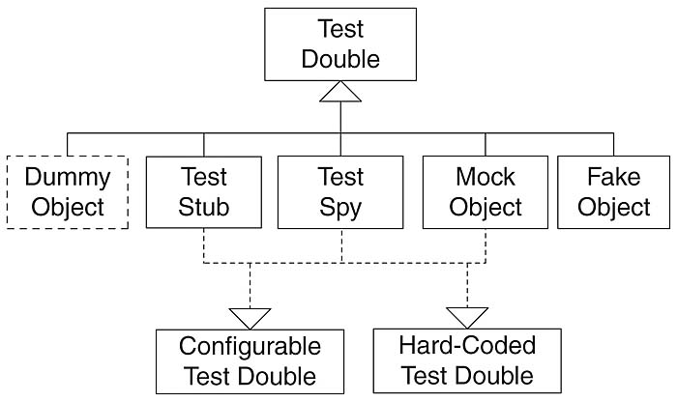
Say Again?
Many people say “mock” when they mean “stub” or “fake”, and it can be quite confusing. Here’s the picture. What’s here?
Dummy objects are used when a parameter is needed for the tested method but without actually needing to use the parameter.
Test stubs are used for providing the tested code with "indirect input”.
Test spys are used for verifying "indirect output" of the tested code, by asserting the expectations afterwards, without having defined the expectations before the tested code is executed.
Mock objects are used for verifying "indirect output" of the tested code, by first defining the expectations before the tested code is executed.
Fake objecta are simpler implementations, like using an a hashmap for database instead of doing real database access.
Join the conversation on Twitter: @DevWeek // #DW2016 // #DevWeek

Slide 31
Test Doubles Are Really, Really Useful Because They…
Allow for rapid execution where depended upon code is slow.
Allow for parallel development of code that is depended upon. Don’t plan for the best way to develop depended upon code. Instead, plan on how you can break those dependencies.
Allow execution of the nooks and crannies in code. How can you test the code that recovers from the power cord being broken?
Allows for testing of nondeterministic code.
Makes the development of your code easier, since any issues from the code you are depending on are not present when you are still developing the code.
This implies that integration goes smoother as well.
Join the conversation on Twitter: @DevWeek // #DW2016 // #DevWeek

Slide 32

A Merchant Wants to Go Postal
Join the conversation on Twitter: @DevWeek // #DW2016 // #DevWeek

Slide 33
Remember how I said before that we can grab UK postal codes using Web Service APIs provided by https://postcodes.io and get geoSpacial data?
Well… We’re going to do that. Real soon now. Honest.
But first, let’s consider how to go about this.
We have a component that we are about to depend on. And that component can slow us down. We have issues to deal with regarding the speed of the iternet connection to the servers. Latency. Throughput. And all sort of nasties. Potentially.
We want to use this oppurtunity to do the right thing when it comes to testing depended upon components. We want a test double.
Join the conversation on Twitter: @DevWeek // #DW2016 // #DevWeek

Slide 34
First, let’s talk about how that test double gets put into the system.
Essentially, we have an iterface to the depended upon component that can be implemented in one of two ways. That’s called inheritence.
Our mindset always has to be “depend on interfaces, not implementations.”
So, as we go about implementing some GeoLocationUtilities, let’s make that class an interface, and implement that class now in GeoLocationUtilitiesFake.
Normally, we would use some sort of Dependency Inversion at this point, such as Spring to “wire” in the implementation of the interface that we want to use. We’ll just keep that in our test environment for now.
Join the conversation on Twitter: @DevWeek // #DW2016 // #DevWeek

Slide 35
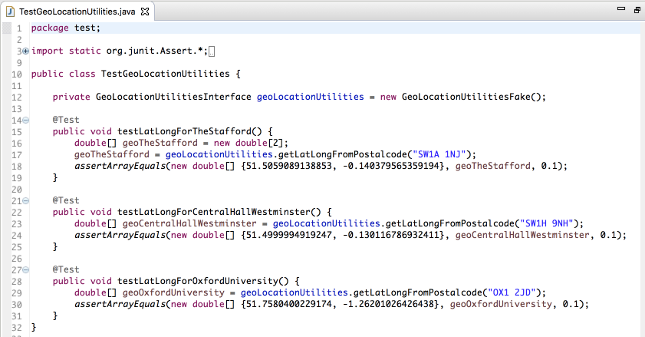
Let’s start with the tests. Always start with the tests. And, I have some tests in mind. I’d like to get the latitudes and longitudes for The Stafford Hotel, Central Hall Westminster, and Oxford University. Something like this:
Join the conversation on Twitter: @DevWeek // #DW2016 // #DevWeek

Slide 36
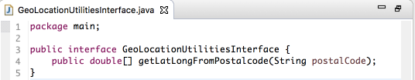
So, we’re looking at something like the following for an interface:
Join the conversation on Twitter: @DevWeek // #DW2016 // #DevWeek

Slide 37
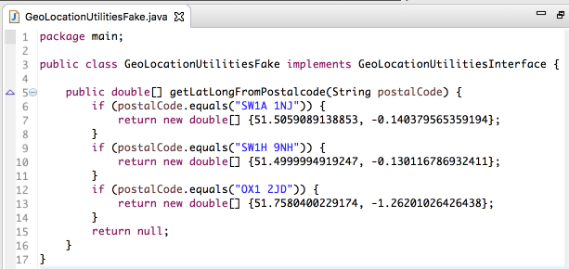
The fake implementation for that interface is a piece of cake:
Join the conversation on Twitter: @DevWeek // #DW2016 // #DevWeek

Slide 38
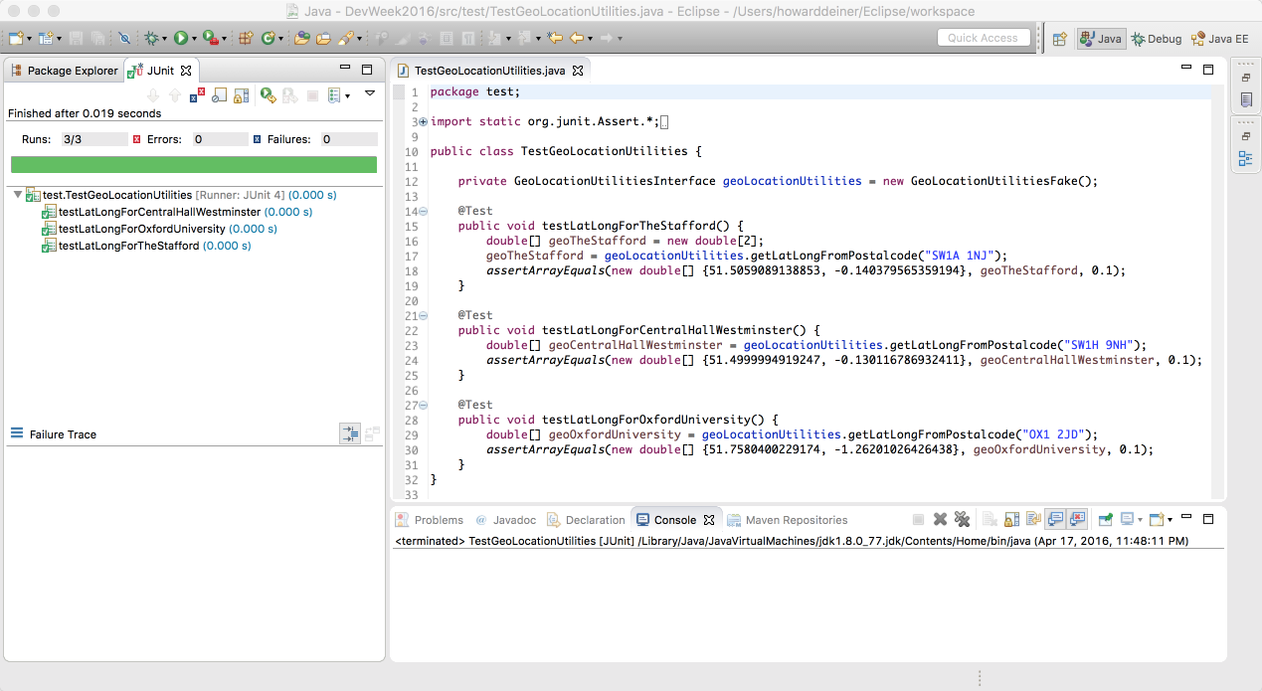
And, of course, the tests work. First time. Every time. And quickly.
Join the conversation on Twitter: @DevWeek // #DW2016 // #DevWeek

Slide 39

A Merchant Actually Goes Postal
Join the conversation on Twitter: @DevWeek // #DW2016 // #DevWeek

Slide 40
To actually go postal, we’re going to need to know a few things.
Exactly how does the Postcode & Geolocation API for the UK work?
How will we easily consume the web service from our Java code?
And what changes will have to occur to code a GeoLocationsUtilitiesImplementation and wire it into the unit testing?
Join the conversation on Twitter: @DevWeek // #DW2016 // #DevWeek

Slide 41
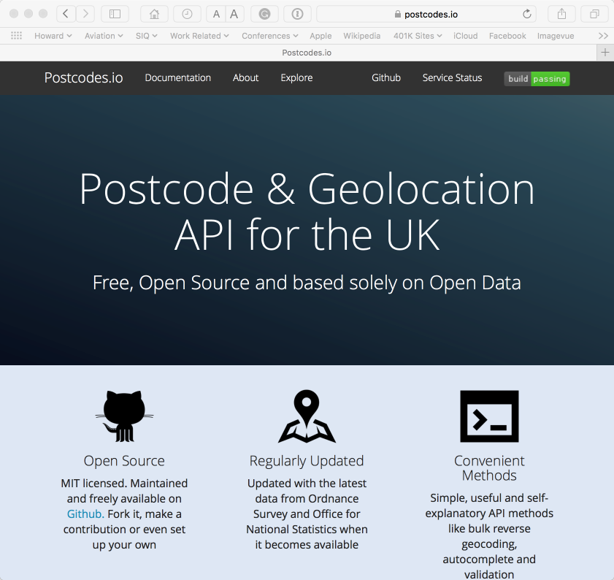
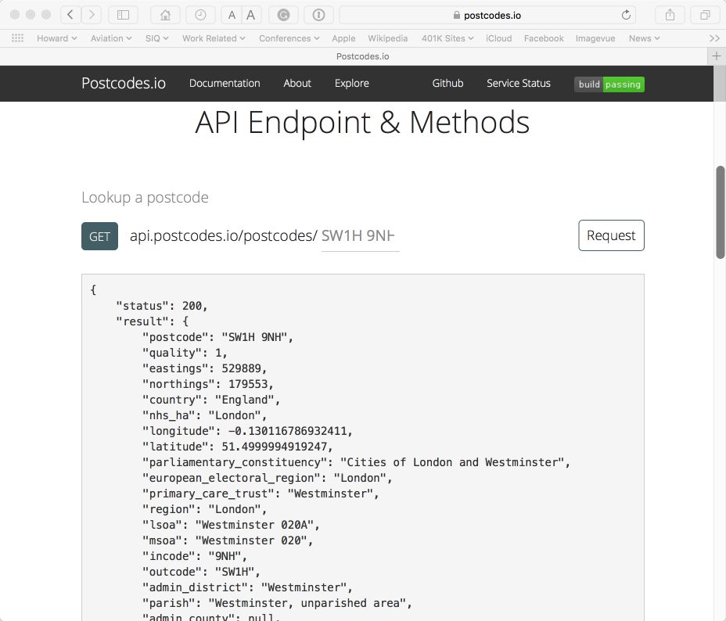
Not too terrible. Standard REST get with JSON output.
Join the conversation on Twitter: @DevWeek // #DW2016 // #DevWeek

Slide 42
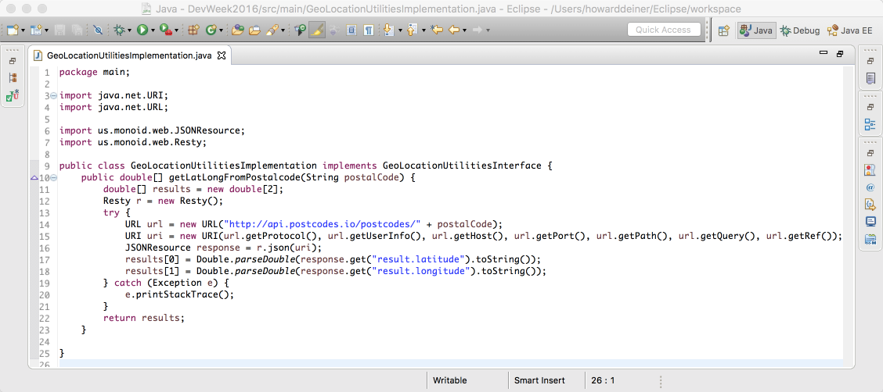
And to do the REST in Java? Try Resty!
Join the conversation on Twitter: @DevWeek // #DW2016 // #DevWeek

Slide 43
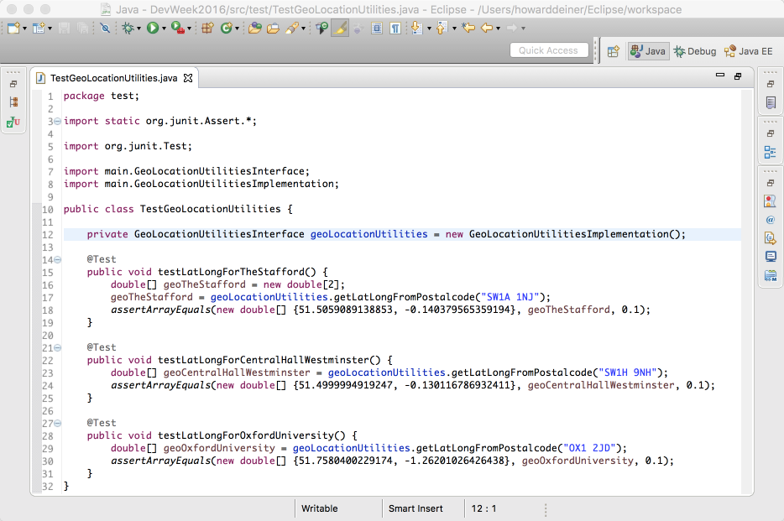
Now, rewire the GeoLocationsUtilitiesInterface to use GeoLocationsUtilitiesImplementation…
Join the conversation on Twitter: @DevWeek // #DW2016 // #DevWeek

Slide 44
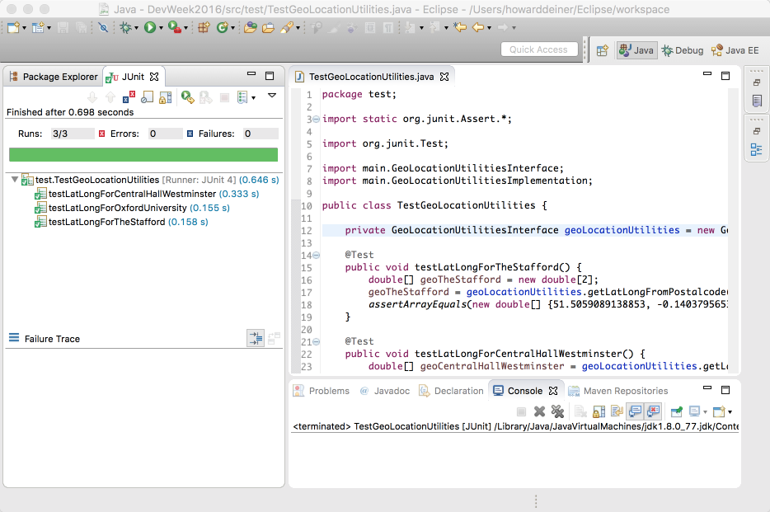
And, without doing anything else, all the test still run. Just a little slower. ☺ (0.6 versus 0.0 sec)
Join the conversation on Twitter: @DevWeek // #DW2016 // #DevWeek

Slide 45

A Customer Class
Join the conversation on Twitter: @DevWeek // #DW2016 // #DevWeek

Slide 46
Finally, we’re getting somewhere to start our online store. Guess we’re going to need customers, right?
Remember to keep your data clean. I happen to like having all minimum attributes passed into the constructor, to make sure that a “minimum object” is created.
Customers have:
A name
An address
A postalcode
A phone number
An eMail address
A credit card
All standing orders to remain in effect. Don’t forget to refactor!
Join the conversation on Twitter: @DevWeek // #DW2016 // #DevWeek

Slide 47
Time to get to work!
I’ll be roming around answering
questions and helping those who need it.
Don’t be afraid to ask for help.
Don’t allow yourself to get stuck!
Join the conversation on Twitter: @DevWeek // #DW2016 // #DevWeek

Slide 48

An Order Class
Join the conversation on Twitter: @DevWeek // #DW2016 // #DevWeek

Slide 49
OK. This is the moment we’ve been waiting for. We finally get to have an order.
Same rules here. Clean data. Clean code. Test anywhere you feel fear.
Orders have:
A merchant
A customer
A distance from merchant to customer
A collecton of line items (extra credit)
Off you go, then. Make us proud!
Join the conversation on Twitter: @DevWeek // #DW2016 // #DevWeek

Slide 50
Oh. That bit about computing the distance from merhcant to customer. You may want this information….
The haversine formula is an equation important in navigation, giving great-circle distances between two points on a sphere from their longitudes and latitudes.
It is a special case of a more general formula in spherical trigonometry, the law of haversines, relating the sides and angles of spherical triangles.
The first table of haversines in English was published by James Andrew in 1805.
No help yet? Next slide.
Join the conversation on Twitter: @DevWeek // #DW2016 // #DevWeek

Slide 51
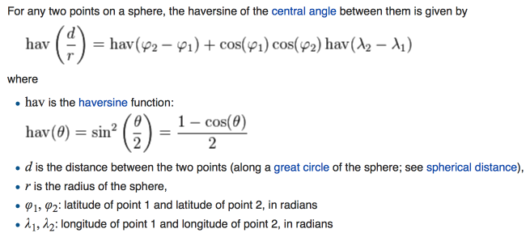
Join the conversation on Twitter: @DevWeek // #DW2016 // #DevWeek

Slide 52
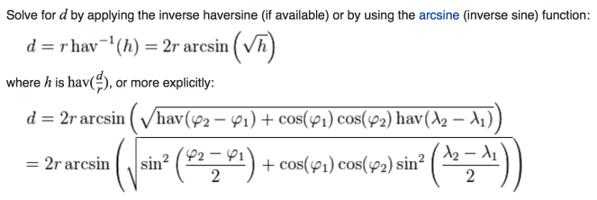
Is this helping or hurting? Try the next slide…
Join the conversation on Twitter: @DevWeek // #DW2016 // #DevWeek

Slide 53
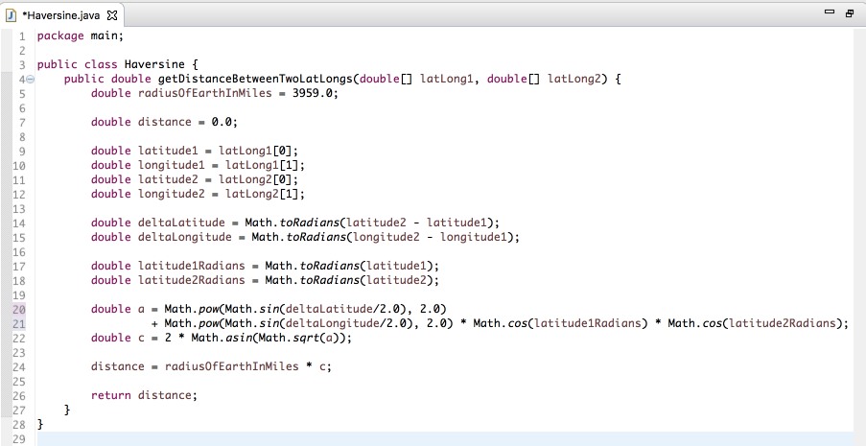
No more helping. You’re on your own now…
Join the conversation on Twitter: @DevWeek // #DW2016 // #DevWeek

Slide 54
Time to get to work!
I’ll be roming around answering
questions and helping those who need it.
Don’t be afraid to ask for help.
Don’t allow yourself to get stuck!
Join the conversation on Twitter: @DevWeek // #DW2016 // #DevWeek

Slide 55

Let’s Talk About Code Coverage
Join the conversation on Twitter: @DevWeek // #DW2016 // #DevWeek

Slide 56
Great code coverage will make your boss really happy. He’ll be overjoyed that everything is really tested and battle hardened.
First of all, if you develop using Test Driven Development, your code coverage will be extremely high. We didn’t do too bad.
Join the conversation on Twitter: @DevWeek // #DW2016 // #DevWeek

Slide 57
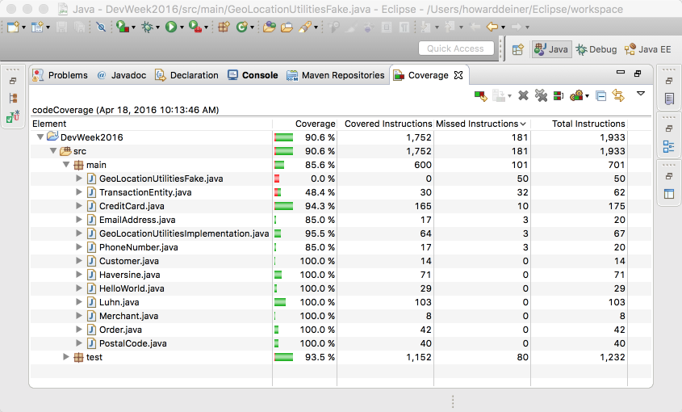
Join the conversation on Twitter: @DevWeek // #DW2016 // #DevWeek

Slide 58
HOWEVER, the code coverage tools only tell us what sections of code were executed.
They don’t tell us anything about the quality of the code.
They are easy to game. If you want great code coverage, don’t bother writing unit tests. After all the code seems done, run a couple of really intense functional tests under Junit (which isn’t such a bad idea). Your code coverage should be pretty good. But you probably didn’t test (or even write) tests to handle difficult edge conditions.
That’s where Mutation Testing comes in.
Mutation Testing assumes that you have 100% code coverage. Then it messes with your code. Inverts conditions, returns nulls instead of values, etc. If your tests still run with the same result, then a mutation lives, and your code is missing some unit tests.
Join the conversation on Twitter: @DevWeek // #DW2016 // #DevWeek

Slide 59
So, how did we do?
Not bad.
I actually wanted more issues to show you, but because we did Test Driven Development, our coverage was quite high.
Remember this. Metrics in general are most useful when we look at trends, and use them as a jumping off point to have a conversation. If you fixate on them, you are bound to be looking at the wrong things.
Join the conversation on Twitter: @DevWeek // #DW2016 // #DevWeek

Slide 60
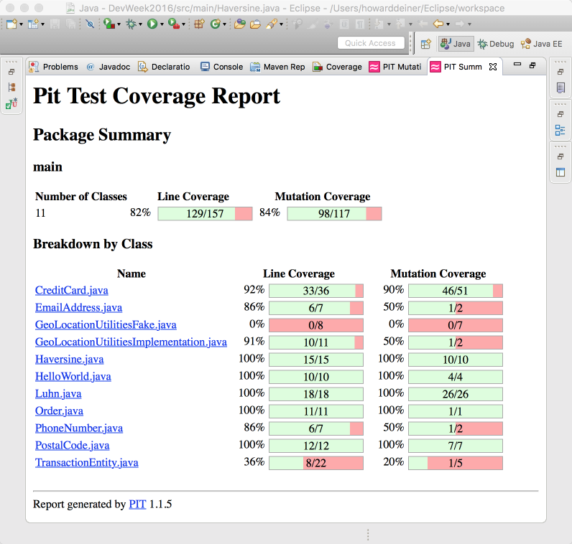
Join the conversation on Twitter: @DevWeek // #DW2016 // #DevWeek

Slide 61
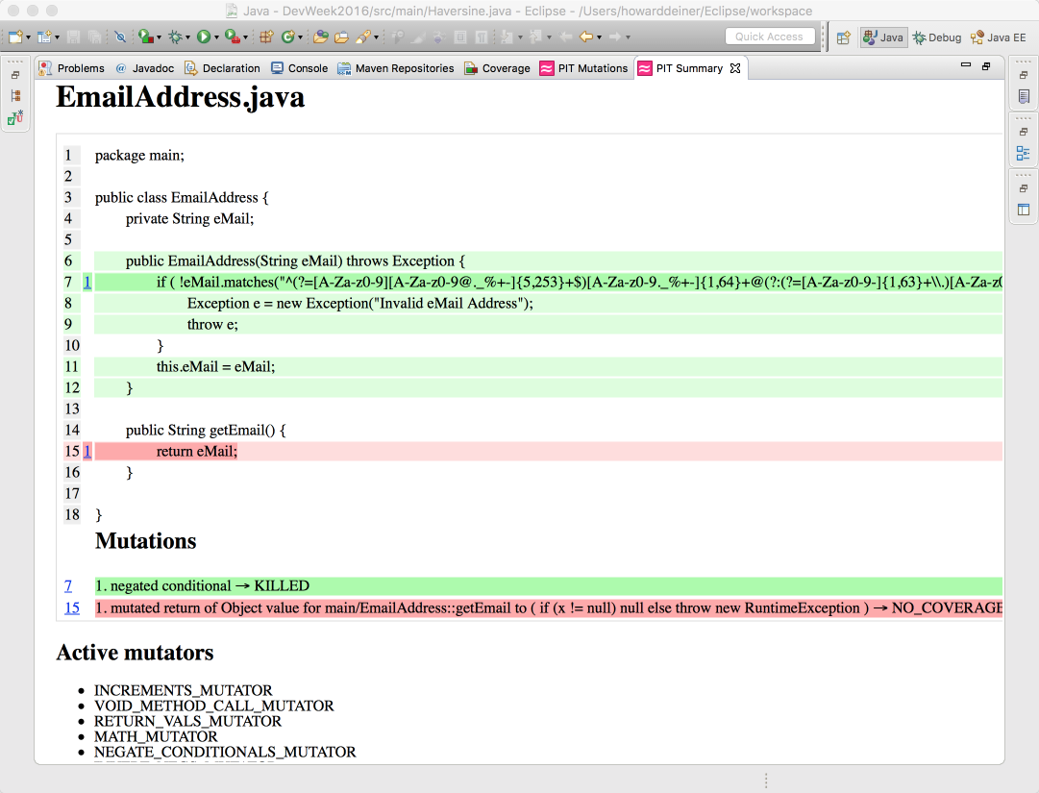
Join the conversation on Twitter: @DevWeek // #DW2016 // #DevWeek

Slide 62

Yes.
We are looking at the end.
Many thanks to all who contributed and persevered during this long day.
Be sure to contact me when issues arise. Even if it’s just to chat.
Time for questions, answers, debate, and then depart.
Join the conversation on Twitter: @DevWeek // #DW2016 // #DevWeek

Slide 63
TDD for the newb Who Wants to Become an Apprentice
Howard Deiner
Agile Technical Practices and Process Coach
SolutionsIQ, Redmond WA, USA
Join the conversation on Twitter: @DevWeek // #DW2016 // #DevWeek

